Slide 1


Doha courses on European union law
POLICY BRIEF WRITING
EU &Environmental Law and HUMAN RIGHTS
Dr. RAFAEL BROWN

Slide 2




DAY 4: PRESENT AND DEFEND
Evidence Based Advocacy Policy Brief
Advocacy Policy Brief as part of an Advocacy Strategy
Promoting Your Policy Brief

Slide 3

EVIDENCE BASED ADVOCACY POLICY BRIEFS
Support your policy briefs with:
data
research findings
research articles
scientific study

Slide 4
EVIDENCE BASED ADVOCACY POLICY BRIEFS
Make your data easy to understand (graphs, pictures, etc)
Explain articles and scientific studies in laymen language

Slide 5
RESEARCH
How to research?
use your policy problem statement
be open to change your idea during or after research

Slide 6
RESEARCH
Where to research?
EU Environment and Climate Change Legislation, https://eur-lex.europa.eu/summary/chapter/20.html
EU Human Rights Legislation, https://eur-lex.europa.eu/summary/chapter/13.html
Research Papers and Articles
Google Scholar

Slide 7
How to Write a Policy Brief
What makes a good policy brief?

Slide 8
How to Write a Policy Brief
concise and clear language
use active voice
make the problem statement clear in the intro
do not be confrontational
rely on evidence not personal opinion

Slide 9
Advocacy Policy Brief
“Policy advocacy is the process of negotiating and mediating a dialogue through which influential networks, opinion leaders, and, ultimately, decision makers take ownership of your ideas, evidence, and proposals, and subsequently act upon them”. (Making Research Evidence Matter, p.261

Slide 10
Advocacy Policy Brief
An advocacy brief must be part of an overall advocacy strategy to be effective.
Design a set of activities
Are there different ways to communicate the message in addition to the policy brief?
Policy Brief, Meetings, Conferences, Social Media

Slide 11
Advocacy Policy Brief
Advocacy Planning Framework
https://advocacyguide.icpolicyadvocacy.org/32-overview-of-the-advocacy-planning-framework-apf

Slide 12
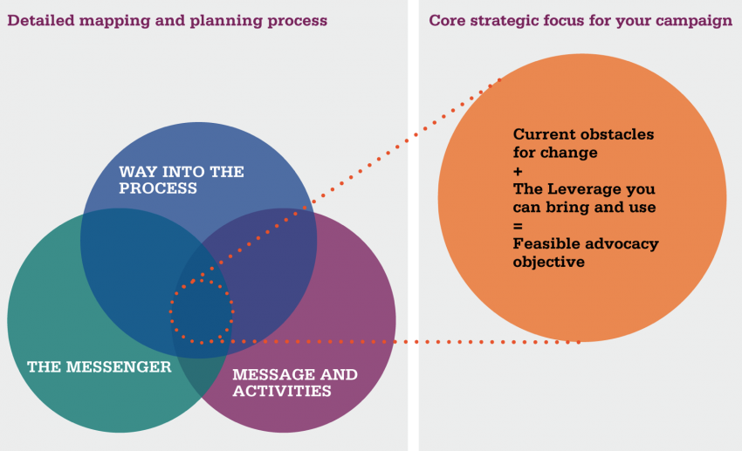
Advocacy Policy Brief
The Advocacy Planning Framework (APF)

Slide 13
Advocacy Planning Framework
Way into the process—what is the best approach to get your ideas into the target policy debate and who will be your target audience(s)?
The messenger—who should lead or be the face of the campaign and what kind of support do you need from others?
Messages and activities—what can you say to the key target audiences that will engage and convince them and how can you best communicate that message to them through carefully chosen advocacy activities and communication tools?

Slide 14
Advocacy Planning Framework
Current obstacles to change—what is currently blocking the policymaking process from moving in the direction you want?
The leverage you can bring and use—what can you bring to and use in the process to move it in the direction you wish?
A feasible policy objective—considering the obstacles that exist and the leverage you have, how far do you think you can move the process?

Slide 15
PROMOTING YOUR POLICY BRIEF
Why should you promote your policy brief?

Slide 16
PROMOTING YOUR POLICY BRIEF
Where can or should you promote?

Slide 17
REMINDER
ADVOCACY POLICY BRIEF DUE DATE
October 28, 2021 at 8pm
Email to me: rbrown@qu.edu.qa

Slide 18
Questions?

