Slide 1


Jean monnet module – Doha courses on European union law – Spring 2021
Dr. Ioannis Konstantinidis

Slide 2





Course 1: The European Union: Legal History and Institutions – Week 6
I. The Court of Auditors
II. The European Central Bank
III. The Committee of the Regions
IV. Agencies
V. Accountability and transparency

Slide 3

Week 5
Learning Outcomes: On completion of this week, students should
  Have developed an advanced understanding of the functions, composition and working procedures of the Court of Auditors, the European Central Bank and the Committee of the Regions
  Have developed an understanding of accountability issues in the European Union

Slide 4

I. The court of auditors
The Court of Auditors

Slide 5

I. The court of auditors
The Court of Auditors
  Established by an amendment to the Treaties in 1975
  It is not, strictly speaking, a court, but more an audit commission
  It is responsible for the external audit of the general budget of the Union. The internal audit is the responsibility of the Financial Controller of each institution

Slide 6

I. The court of auditors
The Court of Auditors – Rationale
  Desire of some of the newer Member States to establish more effective audit arrangements
  Desire of the European Parliament to have greater power in the financial affairs of the Union
  An independent audit body is seen by the European Parliament as an important part of establishing greater financial control. It had, initially, the status of a separate body but, since the TEU came into effect in 1993, it has been classed as one of the Union institutions

Slide 7
II. The European central bank
The European Central Bank

Slide 8
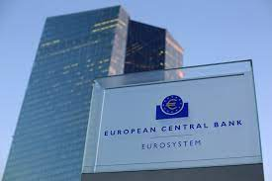
II. The European central bank
The European Central Bank
  Article 13(1) TEU recognizes the European Central Bank (ECB) as one of the Union institutions
  The ECB was initially set up as part of the progression towards economic and monetary union

Slide 9
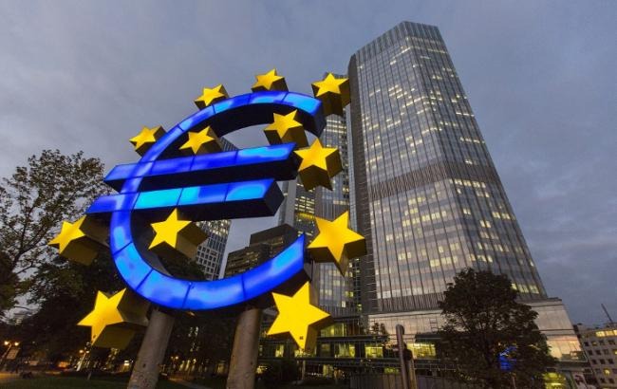
II. The European central bank
The European Central Bank
  The ECB has legal personality and can enact legislation, impose fines, submit opinions and be consulted within its field of operation
  The ECB works with the national banks of the Member States to form the European System of Central Banks (ESCB). The main purpose of the ESCB is to maintain price stability
  Additionally, the ECB works with the national banks of the Member States whose currency is the euro to form the Eurosystem, through which they conduct the monetary policy of the Union

Slide 10

III. The committee of the regions
The Committee of the Regions

Slide 11
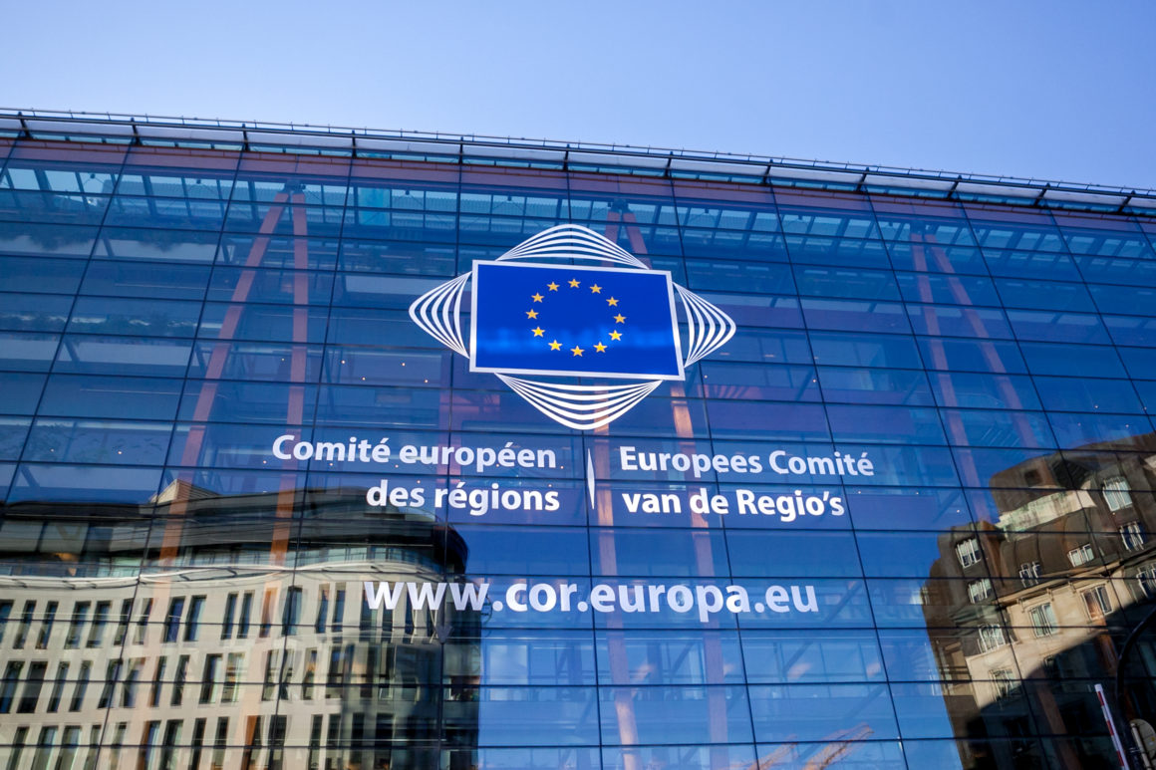
III. The committee of the regions
What is the rationale behind the creation of the Committee of the Regions?
  The Committee of the Regions is not recognized by Article 13(1) TEU as one of the Union institutions but is mentioned in Art 13(4) TEU
  It was intended to represent a move towards more region-orientated decision-making and to create ‘an ever closer union among the peoples of Europe’

Slide 12
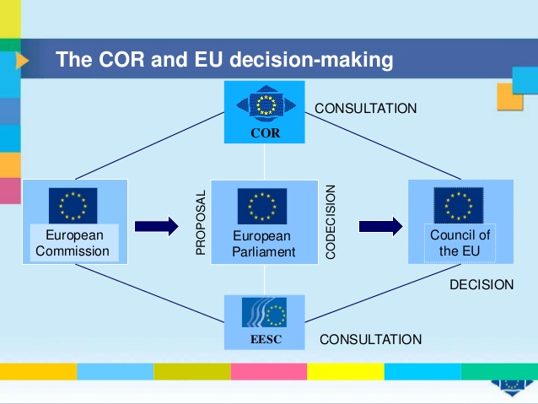
III. The committee of the regions
Functions
  Prior to the ToL: its principal role was to deliver opinions on legislation when consulted by the European Parliament, the Council or the Commission
  It issued opinions on its own initiative in appropriate cases (Art 307 TFEU)
  Its members are not bound by mandatory instructions and members are completely independent in the performance of their duties

Slide 13

III. The committee of the regions
Functions
  After the entry into force of the ToL: the Committee has been given the additional power to challenge legislative proposals it considers to be in breach of the principle of subsidiarity
  The President of the Committee of the Regions, or the Committee’s member who is responsible for drawing up the draft opinion, may propose that an action be brought before the Court of Justice

Slide 14

III. The committee of the regions
Composition
  Members are appointed for a period of five years and they may be reappointed
  Seats are allocated according to the relative population of each Member State. The number of members of the Committee of the Regions shall not exceed 350
  Members need to have an electoral mandate to represent citizens at a local level. No member of the Committee shall at the same time be a Member of the European Parliament

Slide 15
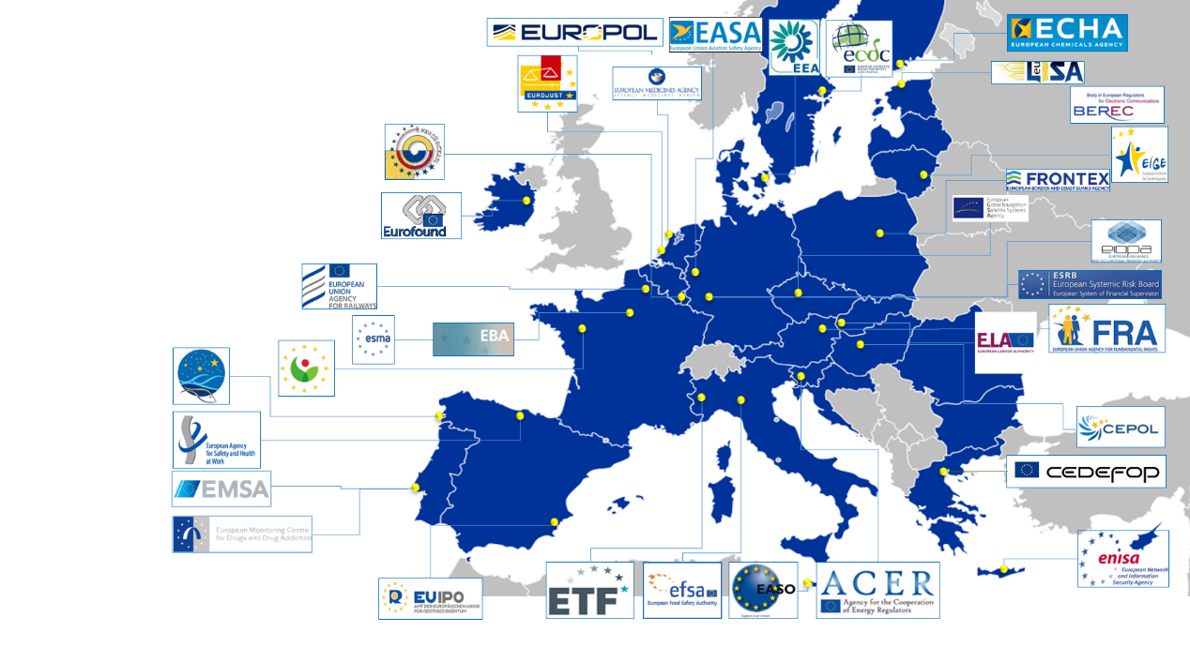
IV. Agencies
Agencies
  EU agencies are independent legal entities, distinct from the main Union institutions, which are created by secondary legislation to perform specific tasks
  There are two main types of agency

Slide 16
IV. Agencies
Agencies
  Decentralized agencies: established for an indefinite period of time and are situated throughout the Union
  They contribute to the implementation of EU policies within a particular policy area
  Examples include the European Environment Agency, the European Food Safety Authority

Slide 17
IV. Agencies
Agencies
  Executive agencies: established by the Commission for a limited period of time to manage specific tasks
  For example, the Research Executive Agency was established to assist the Commission in achieving specific objectives related to research and technological development in the EU

Slide 18
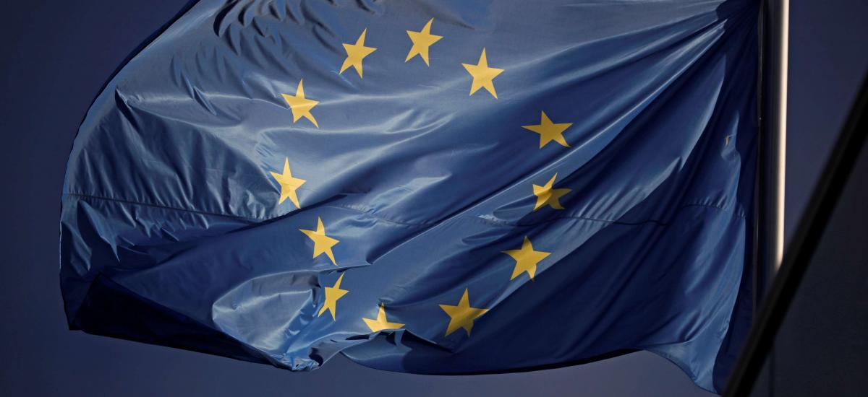
V. Accountability and transparency
Democratic accountability
  EU: an organization having a double democratic mandate through a Parliament representing EU citizens and a Council representing the elected governments of the Member States
  Common criticism: it lacks direct democratic accountability to its citizens. This argument reflects the limited powers of the European Parliament, which is the only institution where citizens directly elect the members that represent them at the Union level

Slide 19
V. Accountability and transparency
Democratic accountability
  The role of Parliament in the legislative process has been strengthened following amendments to the EU Treaties
  Co-decision procedure placing the Parliament on an equal footing with the Council in the legislative process. This procedure, which now applies in the vast majority of cases, was renamed as the ordinary legislative procedure

Slide 20
V. Accountability and transparency
Democratic accountability
  It can also be argued that a democratic deficit remains in relation to Parliament’s inability to dismiss individual Commissioners and to hold members of the Council to account
  Although Council documents are now available after meetings and Council deliberations on legislative acts are now open to the public, other meetings of the Council generally take place behind closed doors

Slide 21
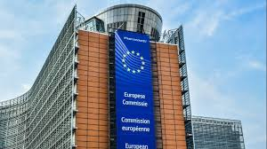
V. Accountability and transparency
Transparency
  The Commission adopted a decision on public access to Commission documents in February 1994. This implemented a joint code of conduct between the Commission and the Council
  The general principle is that the public should have the widest possible access to documents held by these two institutions, subject to public or private interests being protected

Slide 22
V. Accountability and transparency
Transparency in the Commission
  Green Papers are communications published by the Commission on a specific policy area. Primarily they are documents addressed to interested parties, organizations and individuals, who are invited to participate in a process of consultation and debate
  White Papers, which often follow a Green Paper, are documents containing proposals for Union action in a specific area. While Green Papers set out a range of ideas presented for public discussion and debate, White Papers contain an official set of proposals in specific policy areas

Slide 23
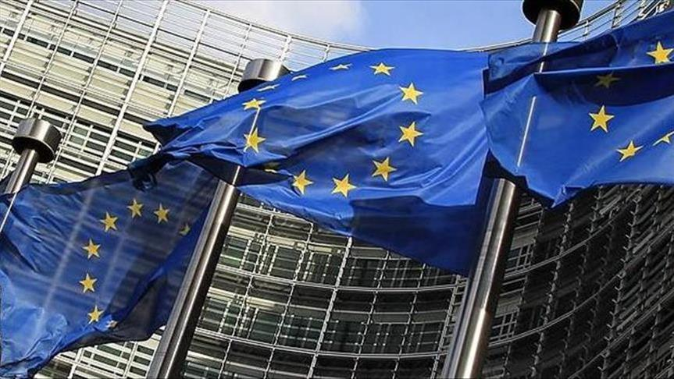
V. Accountability and transparency
Transparency in the Council
  Discussions in the Council have previously been held in secret
  However, in order to meet the requirement of transparency, Article 16(8) TEU now provides that the Council will meet in public when it deliberates and votes on a draft legislative act

Slide 24
V. Accountability and transparency
Transparency of the Parliament
  13 December 2016: the Parliament adopted changes to its Rules of Procedure with the aim of enhancing the transparency and efficiency of the institution
  The changes require MEPs to make more frequent and detailed declarations of their financial interests and bans MEPs from taking paid lobbying jobs whilst in office
  In addition, the rules provide for greater scrutiny by the Parliament of Commissioners’ potential conflicts of interest, both at the beginning of their term and at any point when there are significant changes to a Commissioner’s portfolios or interests

Slide 25
Next Week: Policy Brief Writing
  ­Readings
  Per the course syllabus

Slide 26
Questions?

