Slide 1


Jean monnet module – Doha courses on European union law – Spring 2021
Dr. Ioannis Konstantinidis

Slide 2





Course 1: The European Union: Legal History and Institutions – Week 5
I. The European Parliament
II. The Court of Justice of the European Union
III. Special Focus on the EU Legislative Process

Slide 3

Week 5
Learning Outcomes: On completion of this week, students should
  Have developed an advanced understanding of the functions, composition and working procedures of the European Parliament, the Court of Justice of the European Union, as well as of the EU legislative process

Slide 4

I. The European parliament
Defining the European Parliament

Slide 5

I. The European parliament
The European Parliament and its functions
  The provisions of the EU Treaties governing the European Parliament are Article 14 TEU and Articles 223–234 TFEU

Slide 6

I. The European parliament
The European Parliament and its functions
  The EEC Treaty (1957), included provision for ‘an Assembly’ whose task was to ‘exercise the advisory and supervisory powers’ conferred upon it
  The Assembly is now called the European Parliament and the words ‘advisory and supervisory’ have disappeared. In 1979, the Parliament became a directly elected body

Slide 7
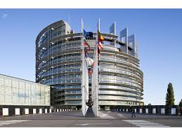
I. The European parliament
The European Parliament and its functions
  Article 14(1) TEU now states that:
    The European Parliament shall, jointly with the Council, exercise legislative and budgetary functions. It shall exercise functions of political control and consultation as laid down in the Treaties. It shall elect the President of the Commission

Slide 8

I. The European parliament
The European Parliament and its functions
  The Parliament represents the interests of the citizens of the European Union
  Is the name “Parliament” somehow misleading? The principal difference between the European Parliament and national parliaments is that it lacks the power to initiate legislation
  Its powers have increased, however, following the changes to decision-making procedures made by the SEA, TEU, ToA, ToN and ToL

Slide 9

I. The European parliament
The powers exercised by the European Parliament
  Participation in the legislative processes of the Union
  Acting as the budgetary authority
  Supervision of the Commission

Slide 10
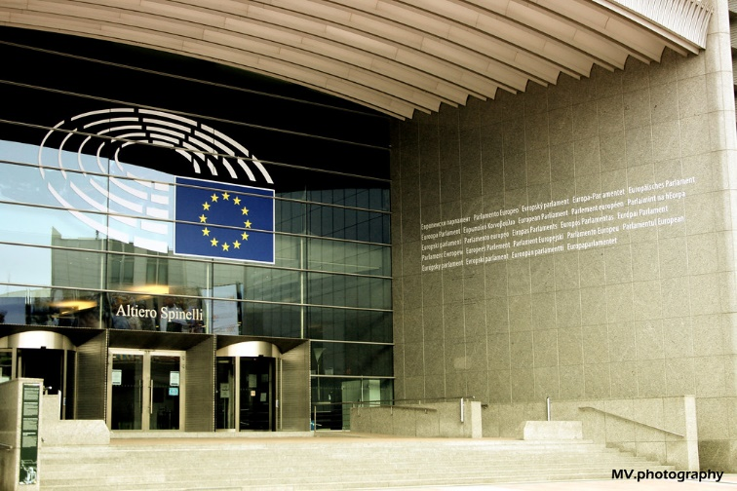
I. The European parliament
The powers exercised by the European Parliament – The budget
  The Union’s budget is drafted by the Commission and placed before the Council and the European Parliament before 1 September each year
  This is necessary because the Union’s financial year runs from 1 January to 31 December
  The budget is divided into two parts: compulsory expenditure (CE) and non-compulsory expenditure (NCE)

Slide 11
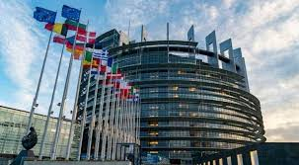
I. The European parliament
The powers exercised by the European Parliament – The budget
  CE relates to those items where the expenditure is required by the EU Treaties, primarily the Common Agricultural Policy, which usually absorbs around 50 per cent of the total budget
  NCE covers such items as social and regional policy, research and aid to non-EU countries

Slide 12
I. The European parliament
The powers exercised by the European Parliament – The budget
  The European Parliament may amend any part of the draft budget, irrespective of whether the item concerns CE or NCE. The Parliament adopts amendments by a simple majority of its component members.
  If this occurs, a meeting of the Conciliation Committee is convened, comprising members of the Council and the European Parliament
  The aim of this Committee is to seek agreement between the members on a joint text (Art 314(5) TFEU). Ultimately, if a joint text cannot be agreed, the Commission is required to submit a new draft budget

Slide 13
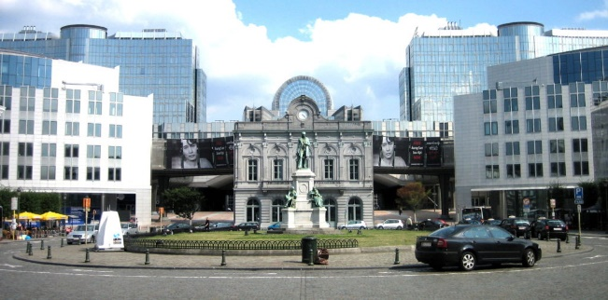
I. The European parliament
The powers exercised by the European Parliament – Supervision of the Commission
  There is close and continuous contact between the Commissioners and the European Parliament
  Although Commissioners are not members of the Parliament, they frequently take part in debates where legislation is under discussion and they will often attend the specialist committees of the Parliament to deal with detailed points arising from Commission proposals. Commissioners have the right to attend the European Parliament and to be heard

Slide 14
I. The European parliament
The powers exercised by the European Parliament – Supervision of the Commission
  The powers of the Parliament have been reinforced by the requirement that a new Commission is subject to a vote of consent by the Parliament
  The effectiveness of this provision was demonstrated in the Parliament’s scrutiny of the 2004–2009 Commission. The Parliament opposed the appointment of Rocco Buttiglione (from Italy), who was subsequently replaced by Franco Frattini and the President-elect requested the replacement of Latvia’s Ingridia Udre and reshuffled two portfolios

Slide 15
I. The European parliament
The Composition of the European Parliament

Slide 16
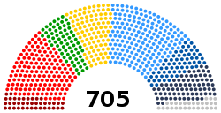
I. The European parliament
The Composition of the European Parliament
  Originally, the European Parliament’s members were nominated by the national parliaments, but now it is the only directly elected institution in the Union

Slide 17
I. The European parliament
The Composition of the European Parliament
  A decision of the Council adopted in June 2018 established that, after Brexit, 46 of the UK’s 73 seats would be left vacant, reducing the total number of MEPs to 705. These seats will become available to new Member States if there are accessions in the future
  The remaining 27 seats will be distributed among 14 Member States that are currently slightly underrepresented

Slide 18
I. The European parliament
The Composition of the European Parliament
  MEPs stand as members of national political parties, but sit within broad political groups rather than national affiliations in the European Parliament
  There are currently 9 groups. The number of seats held by each political group after Brexit will depend on the affiliation of the 27 new MEPs

Slide 19
I. The European parliament
The Composition of the European Parliament
  What is the rationale behind the establishment of political groups?
  Primarily they are formed to provide mutual ideological support and identification. In addition, there are organizational benefits, including funds for administrative and research purposes which are better deployed in support of groups than for individuals

Slide 20
II. The Court of justice of the European union
The Court of Justice of the European Union

Slide 21

II. The Court of justice of the European union
The Court of Justice of the European Union
  The Court of Justice of the European Union plays a pivotal role in the Union
  The provisions of the EU Treaties governing the Court of Justice of the European Union are Article 19 TEU and Articles 251–281 TFEU, as well as the Protocol No. 3 on the Statute of the Court of Justice of the European Union (in force since 2009)

Slide 22

II. The Court of justice of the European union
The Court of Justice of the European Union
  The Court of Justice of the European Union shall include the Court of Justice, the General Court and specialized courts
  It shall ensure that in the interpretation and application of the Treaties the law is observed

Slide 23
II. The Court of justice of the European union
The Court of Justice of the European Union
  Headquarters: Luxembourg
  Working language: French

Slide 24

II. The Court of justice of the European union
The Court of Justice – Jurisdiction
  To give preliminary rulings under Article 267 TFEU at the request of a national court or tribunal
  To establish whether or not a Member State has failed to fulfil an obligation under the Treaty. Actions for this purpose may be brought by the Commission under Article 258 TFEU, or by a Member State under Article 259 TFEU

Slide 25
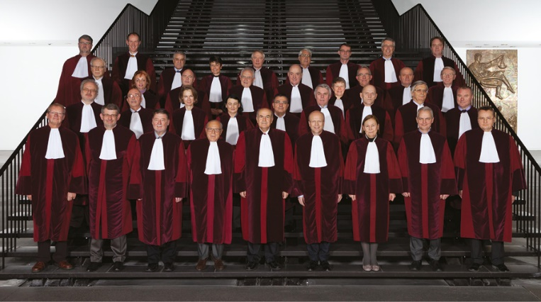
II. The Court of justice of the European union
The Court of Justice – Jurisdiction
  To exercise unlimited jurisdiction with regard to penalties in actions brought by the Commission under Articles 260(2) and 261 TFEU
  To review the legality of an act, or of a failure to act, of the Union institutions, at the request of Member States, the European Parliament, the Council or the Commission
  To grant compensation for damage caused by Union institutions in actions brought by Member States, and natural and legal persons under Articles 268 and 340 TFEU

Slide 26
II. The Court of justice of the European union
The Court of Justice – Composition
  Article 19(2) TEU provides that the Court of Justice will consist of one judge from each Member State, who will be assisted by Advocates General. An Advocate General is an independent adviser to the Court

Slide 27
II. The Court of justice of the European union
The General Court
  To cope with the great increase in the work of the Court of Justice, the SEA provided for the creation of a Court of First Instance (CFI) to be attached to the Court of Justice (former Art 225 EC Treaty). When the ToL came into force on 1 December 2009, the CFI was renamed the General Court (Art 19(1) TEU)

Slide 28
II. The Court of justice of the European union
The General Court
  It hears actions taken against the institutions of the European Union by individuals and member States, although certain matters are reserved for the Court of Justice
  Its decision can be appealed before the Court of Justice

Slide 29
II. The Court of justice of the European union
The General Court – Composition
  Two judges per Member State as from 1 September 2019

Slide 30
II. The Court of justice of the European union
Specialized Courts
  Article 257 TFEU empowers the European Parliament and the Council to establish ‘specialized courts’ – this is a renaming of the former judicial panels which were established by the Council, acting unanimously, under the former Article 225a EC Treaty

Slide 31
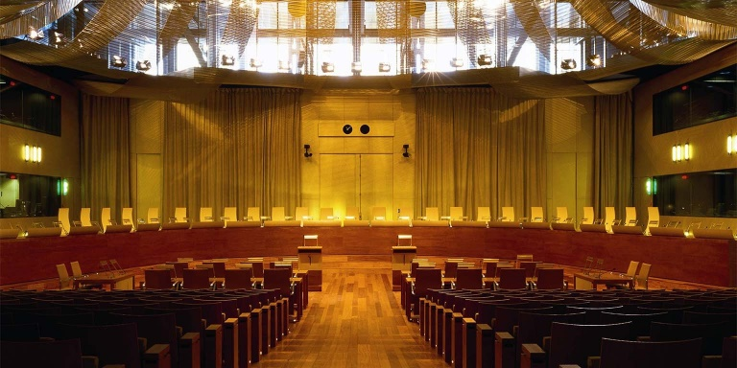
II. The Court of justice of the European union
Specialized Courts
  Decisions of a specialized court are subject to a right of appeal on points of law (and in certain circumstances matters of fact) to the General Court

Slide 32
II. The Court of justice of the European union
Specialized Courts
  The only specialized court to have been established so far was the European Union Civil Service Tribunal, which operated between 2005 and 2016

Slide 33
III. The legislative procedure in the European union
Law-making in the European Union

Slide 34
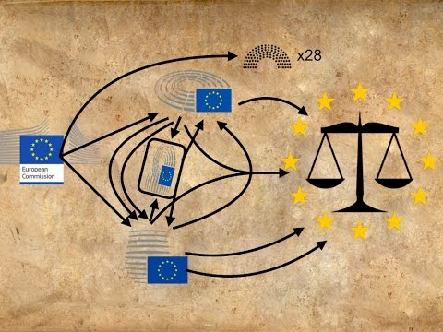
III. The legislative procedure in the European union
The ordinary legislative procedure – Co-decision
  The right of initiative rests with the Commission
  This means that neither the Council nor the Parliament can directly propose new legislation, albeit both may request the Commission to do so

Slide 35
III. The legislative procedure in the European union
The ordinary legislative procedure – First Reading
  The procedure’s first reading is kickstarted by the submission of the Commission's proposal to both the Parliament and the Council. The Parliament is the first one to give its opinion and can choose three options: fully agree with it, amend it and send to the Council or reject it
  If the European Parliament decides to reject the proposal at this stage the procedure ends, and the Act is not adopted

Slide 36
III. The legislative procedure in the European union
The ordinary legislative procedure – First Reading
  The Council can vote by qualified majority to adopt the proposal in the wording which corresponds to the position of the European Parliament or can adopt is own position on the proposed legislation and then send it back to the Parliament

Slide 37
III. The legislative procedure in the European union
The ordinary legislative procedure – Second reading
  If the co-legislators are not able to agree on a position in the first reading, the procedure enters its second reading. The proposal goes back to the European Parliament where it can be approved by a majority of the votes cast or by tacit agreement
  The proposal can also be rejected or amended

Slide 38
III. The legislative procedure in the European union
The ordinary legislative procedure – Second reading
  Parliamentary amendments mean that the proposed Act must go back to the Council where, by qualified majority, the Institution must choose one of the following: either i) accept all amendments or ii) reject all amendments. There is no more room for back-and-forth modifications between co-legislators
  If the Council fails to accept the Parliament’s demands, a Conciliation Committee is created

Slide 39
III. The legislative procedure in the European union
The ordinary legislative procedure – Conciliation Committee
  Conciliation aims at bringing the legislative procedure to a successful conclusion through closer cooperation between Parliament and Council, fostered by the Commission
  The Committee is composed of an equal number of representatives from the Council and from the European Parliament

Slide 40
III. The legislative procedure in the European union
The ordinary legislative procedure – Conciliation Committee
  If the Conciliation Committee reaches a joint proposal, the third, and last, reading begins
  Both Council and Parliament have a 6-week deadline to approve the joint agreement

Slide 41
Next Week: Other EU Institutions – Accountability and Transparency
  ­Readings
  Per the course syllabus

Slide 42
Questions?

