Slide 1


Jean monnet module – Doha courses on European union law – Fall 2023
Dr. Ioannis Konstantinidis

Slide 2





Course 2: The EU Charter of Fundamental Rights – Week 5
I. The Drafting and Structure of the Charter
II. The Substantive Provisions and the Scope of Application/Interpretation of the EU Charter
III. Concluding Remarks

Slide 3

Week 5
Learning Outcomes: On completion of this week, students should
  Have developed an advanced understanding of the EU Charter of Fundamental Freedoms

Slide 4

I. The drafting and structure of the EU Charter
The European Union Charter of Fundamental Rights (EU Charter)

Slide 5
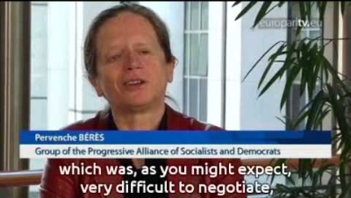
I. The drafting and structure of the EU Charter
The European Union Charter of Fundamental Rights (EU Charter)

Slide 6
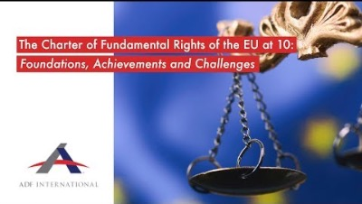
I. The drafting and structure of the EU Charter
The European Union Charter of Fundamental Rights (EU Charter)

Slide 7

I. The drafting and structure of the EU Charter
The Importance of Adopting the EU Charter
  The adoption of the EU Charter is one of the most significant constitutional steps in the history of the EU: Why?
    1. The Charter was drafted using a new (and some might say revolutionary) procedure which involved not only representatives of national governments but also representatives of national and European parliaments

Slide 8
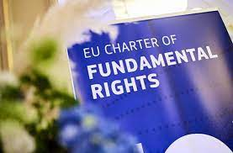
I. The drafting and structure of the EU Charter
The Importance of Adopting the EU Charter
  The adoption of the EU Charter is one of the most significant constitutional steps in the history of the EU: Why?
    2. The fact that Member States felt the need to adopt a fundamental rights document (even though there is no general fundamental rights competence for the EU), is a further step in the long process of the constitutional evolution of the EU

Slide 9
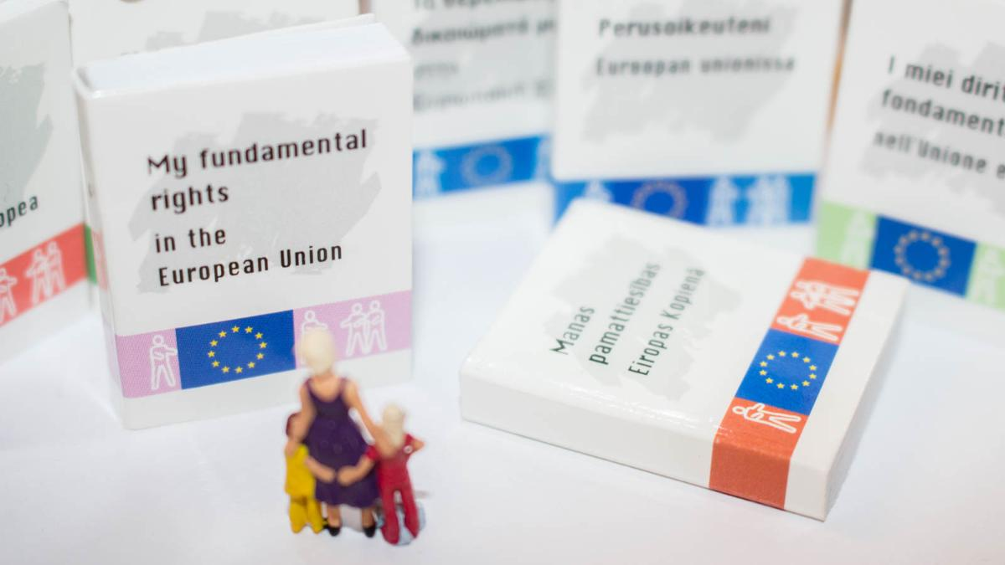
I. The drafting and structure of the EU Charter
The Cologne EU Council of 1999 and Its Conclusions
  Charter should contain:
    A. The rights and procedural guarantees contained in the ECHR and those derived by the common constitutional traditions, as general principles of European law
    B. The rights pertaining to Union citizens (e.g. right to move and reside in Member States)
    C. Account was to be taken of the social rights contained in the European Social Charter and the Community Charter of the Fundamental Social Rights of Workers

Slide 10

I. The drafting and structure of the EU Charter
The Cologne EU Council of 1999 and Its Conclusions
  Body in charge of drafting the EU Charter:
    A. Representatives of the heads of state and government
    B. President of the Commission
    C. Representatives of national parliaments
    D. Members of the European Parliament

Slide 11

I. The drafting and structure of the EU Charter
The Cologne EU Council of 1999 and Its Conclusions
  Treaty drafting novelty?
  Normally international treaties are drafted and negotiated by representatives of national governments and are then presented to national parliaments for ratification
  Given the fundamental importance of the document to be drafted, the Member States decided to include in the discussions representatives of directly elected parliaments hence enhancing the democratic credentials of the drafting body

Slide 12
I. The drafting and structure of the EU Charter
The Tampere EU Council of 1999
15 representatives of the heads of state or government of the Member States
1 representative of the Commission
16 representatives of the European Parliament
30 representatives of the national parliaments (two for each Member State)

Slide 13

I. The drafting and structure of the EU Charter
Negotiations Leading to the Adoption of the EU Charter
Democratic legitimacy: all documents were made public and placed on the internet
Acceding Member States as well as non-governmental organizations (NGOs) were allowed to participate

Slide 14
I. The drafting and structure of the EU Charter
Negotiations Leading to the Adoption of the EU Charter
10 months to draft the EU Charter
It was proclaimed by the European Parliament, the Commission and the Council on 7 December 2000 in Nice (France)
Initially, the EU Charter was not legally binding – Issue settled by the Treaty of Lisbon (Article 6(1))

Slide 15
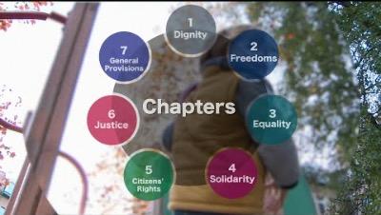
I. The drafting and structure of the EU Charter

Slide 16

I. The drafting and structure of the EU Charter
A Novel Structure?
Departure from the traditional dichotomy of civil and political rights/economic and social rights
It approaches fundamental rights as an individual whole
EU Charter is divided into titles according to six fundamental values: dignity, freedom, equality, solidarity, citizens’ rights, and justice

Slide 17
I. The drafting and structure of the EU Charter
A Novel Structure?
They are complemented by a preamble and the so-called horizontal provisions:
  General provisions (scope of application of the Charter), the legitimate grounds of limits on, and derogations from, Charter rights, as well as the relationship with the ECHR, national constitutions, and international human rights treaties

Slide 18
IΙ. The Substantive Provisions and the Scope of Application / Interpretation of the EU Charter
Τitle I: Dignity – Article 1-5
Title I contains those rights which are essential to the enjoyment of any other right: the right to human dignity; the right to life; the right to the integrity of the person, which contains new generation rights such as the principle of informed consent in relation to medical intervention; the prohibition of torture and inhuman and degrading treatment; and the prohibition of slavery and forced labor

Slide 19
IΙ. The Substantive Provisions and the Scope of Application / Interpretation of the EU Charter
Τitle II: Freedom – Articles 6-19
This title contains some of the traditional civil and political rights: right to liberty; the right to private life; the right to freedom of expression; the right to property
Some new generation rights: the right to protection of personal data
Some socio-economic rights, such as the right to work and the right to education

Slide 20
IΙ. The Substantive Provisions and the Scope of Application / Interpretation of the EU Charter
Τitle II: Freedom – Articles 6-19
Comment: It is interesting to note that despite the Charter’s ambitions to reflect a more contemporary take on rights, the right to freedom of thought and religion was not broadened explicitly to include the right not to hold a religious belief, as suggested by many NGOs

Slide 21
IΙ. The Substantive Provisions and the Scope of Application / Interpretation of the EU Charter
Τitle III: Equality – Articles 20-26
Title III contains traditional equality rights (non-discrimination on grounds of sex, race, sexual orientation, religion, belief, etc.)
It also provides for the right not to be discriminated against on grounds of nationality within the scope of application of the Treaty and the rights of more vulnerable members of society such as children, the elderly, and disabled people

Slide 22
IΙ. The Substantive Provisions and the Scope of Application / Interpretation of the EU Charter
Τitle IV: Solidarity – Articles 27-38
Title IV was the most contested part of the EU Charter in certain EU members
Traditional social rights and ‘principles’, such as the right to collective bargaining and action, including the right to strike and protection against unjustified dismissal; the right to fair working conditions as well as protection for children and young people at work, and protection for the family, including protection against dismissal linked to maternity

Slide 23
IΙ. The Substantive Provisions and the Scope of Application / Interpretation of the EU Charter
Τitle IV: Solidarity – Articles 27-38
It also includes ‘recognition’ of social security and social assistance; access to services of general economic interests; and the ‘right’ to health care, as well as the obligation for the Union to ensure a high level of environmental and consumer protection in its policies

Slide 24
IΙ. The Substantive Provisions and the Scope of Application / Interpretation of the EU Charter
Τitle V: Citizens’ Rights – Articles 39-46
This article benefits mainly EU citizens
It includes the right to vote and stand for elections in the European Parliament and in municipal elections in the Member State of residence, the right to move and reside freely in the territory of the Member States, and the right to consular and diplomatic protection, all limited to Union citizens

Slide 25
IΙ. The Substantive Provisions and the Scope of Application / Interpretation of the EU Charter
Τitle V: Citizens’ Rights – Articles 39-46
The ‘administrative rights’ in this title, such as the right to good administration, the right to access documents, the right to complain to the Ombudsman, and the right to petition, are also available to non-EU citizens residents

Slide 26
IΙ. The Substantive Provisions and the Scope of Application / Interpretation of the EU Charter
Τitle VI: Justice – Articles 47-50
Title VI is concerned with the administration of justice and draws mainly on the ECHR and on the common constitutional traditions to the Member States
It includes the right to an effective remedy and a fair trial; the right to be presumed innocent and the right of defence; the principle of legality and proportionality of criminal offences and penalties; and the principle of ne bis in idem, which is to say the right not to be tried or punished twice for the same offence

Slide 27
IΙ. The Substantive Provisions and the Scope of Application / Interpretation of the EU Charter
Article 51: EU Charter Scope of Application
The EU Charter codifies existing case law making rights more visible to the citizen. Its primary addressee, then, is the EU
Member States are also bound by EU fundamental rights when they exercise a discretion which has either been conferred by Union law (i.e. when they implement a Union law instrument) or when they bring themselves within the scope of EU law by limiting or derogating from one of the rights conferred by the Treaties

Slide 28
IΙ. The Substantive Provisions and the Scope of Application / Interpretation of the EU Charter
Article 51: EU Charter Scope of Application
Article 51(1) therefore states that the provisions of the Charter are addressed to the EU Institutions, agencies, and bodies and to the Member States ‘only’ when they implement Union law
What constitute “implementation” for the purposes of Article 51(1)?
It covers cases in which the Member State is implementing or giving effect to a directive, regulation, or decision, as well as cases where the Member State is limiting one of the rights granted by the Treaty

Slide 29
IΙ. The Substantive Provisions and the Scope of Application / Interpretation of the EU Charter
Article 51: EU Charter Scope of Application
Case Åklagaren v. Hans Åkerberg Fransson
Several intervening Member States, together with the Commission, argued that the Charter was not applicable since the legislation which formed the basis for the proceedings was not implementing EU law

Slide 30
IΙ. The Substantive Provisions and the Scope of Application / Interpretation of the EU Charter
Article 52: EU Charter Scope of Interpretation
Very few fundamental rights are absolute
The vast majority of fundamental rights can be limited in order to protect the rights of others and/or to ensure that public policy objectives can be carried out

Slide 31
IΙ. The Substantive Provisions and the Scope of Application / Interpretation of the EU Charter
Article 52: EU Charter Scope of Interpretation
The Charter provides for just one general derogation and limitation clause. Article 52(1) states that limitations on the exercise of Charter rights must:
  be provided by law;
  respect the essence of those rights;
  respect the principle of proportionality; and
  be necessary to meet the objectives of ‘general interest recognized by the Union or the need to protect the rights and freedoms of others

Slide 32
IΙ. The Substantive Provisions and the Scope of Application / Interpretation of the EU Charter
Article 52: EU Charter Scope of Interpretation
Note on Article 53:`this Article ensures that the protection afforded by the Charter cannot fall below that afforded by international law and international agreements to which the EU or all of the Member States are parties, including the ECHR, and by the Member States’ constitutions

Slide 33

III. Concluding Remarks
  Whether the EU Charter will open a new era in the development of the EU from limited economic cooperation to a full political, economic, and social union remains to be seen
  Future practice and case law of the European Court of Justice will provide more answers

Slide 34
Next Week: - The European Union and the European Convention on Human Rights
- Τηε European Union External Action and Human Rights
  ­Readings
  Per the course syllabus

Slide 35
Questions?

